Slide 1
Lertkiet Lertchayantee
Data Analyst Portfolio

Slide 2
About Me
With a strong foundation in engineering and experience managing electrical projects in industrial plants, I naturally transitioned into the field of data analytics. My previous role involved reconciling and analyzing large datasets in Excel to inform engineering decisions, which laid the groundwork for my advanced analytical capabilities.
Completing the CareerFoundry Data Analytics program allowed me to deepen my expertise in data cleaning, analysis, and visualization while acquiring technical skills in SQL and Python. Additionally, I honed my ability to create insightful visualizations and design impactful storyboards in Tableau, enabling me to deliver actionable insights and data-driven solutions.

Slide 3
Portfolio Case Study Overview
01
02
03
GameCo
Influenza Season
Rockbuster Stealth
Global video game
sales analysis
Providing staff analysis for medical facilities
Strategy analysis for the
new online video service

Slide 4
Portfolio Case Study Overview
04
05
06
Instacart
Pig E. Bank
House Sales in King County
Analysis to uncover data
on sales patterns
Data mining analysis
for a global bank
Insights into House Prices
Uncovered

Slide 5
GameCo
Global video game sales analysis

Slide 6
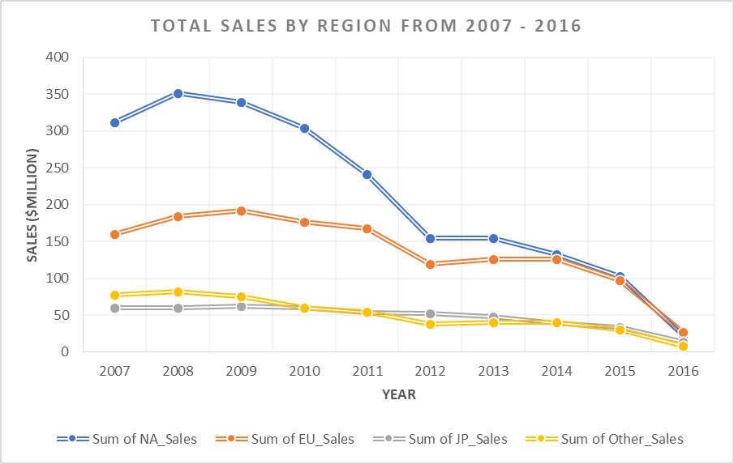
GameCo
Global video game sales analysis
Background
GameCo is a new video game
company discovering that sales
for the various geographic
regions have stayed the same
over time.
Methods
- Grouping/sorting/filtering data
- Descriptive analysis
- Data cleaning
- Data visualization
Tools
- MS Excel
Goal
Conduct a comprehensive descriptive analysis of a video game dataset to gain deeper insights
into market trends, player preferences, and factors influencing game performance
Data
Data was drawn from the VGChartz website and provided by CareerFoundry
Link
1. Raw Data 2 Additional Files Related to This project
Market data reveals a notable decrease in overall market size, shifts in regional market dominance, and the emergence of growth opportunities in smaller, previously underrepresented regions.
These trends suggest a dynamic and evolving market landscape that requires a more targeted and adaptive approach to marketing strategy.

Slide 7
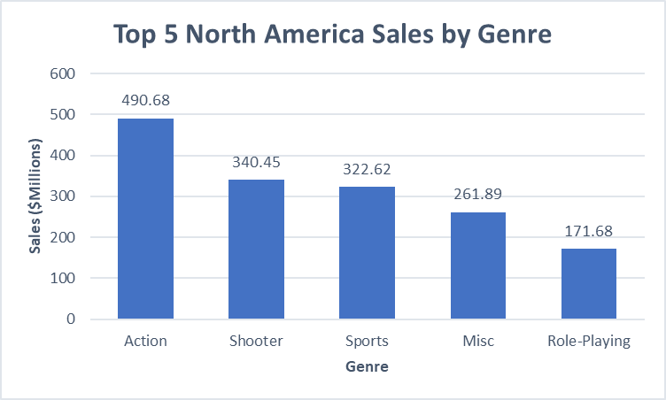
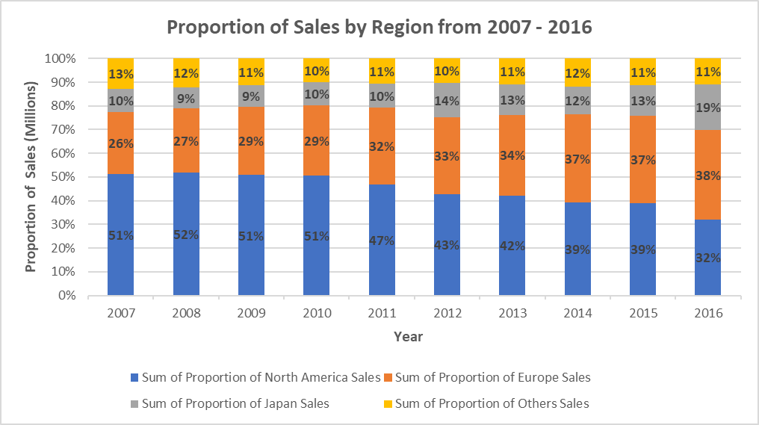
Result and Insights
In North America, action and shooter games are the most popular ones over the years (2007 - 2016).
The proportion of sales in North America has taken majority, but it has decreased over the years

Slide 8
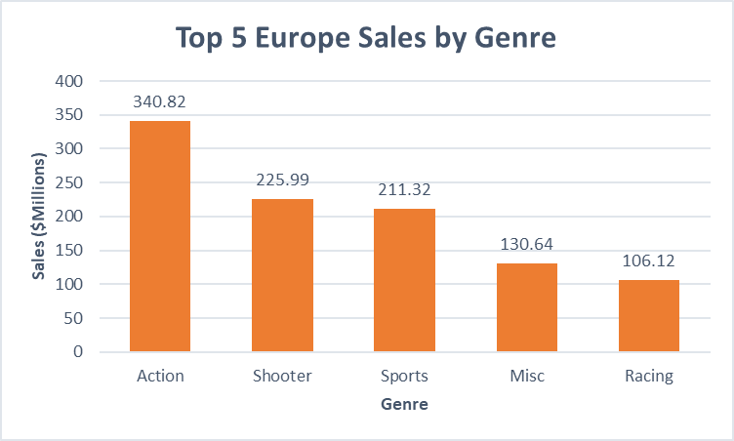
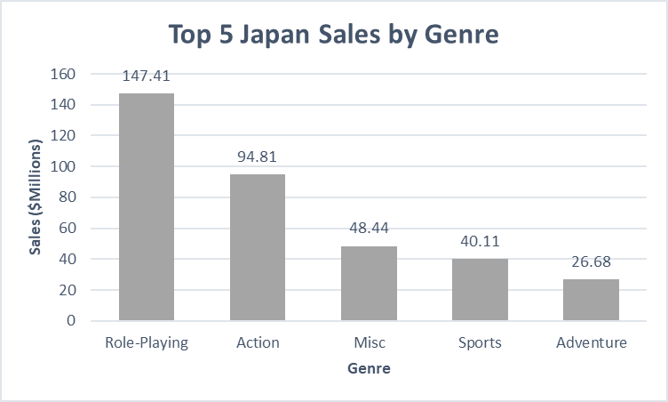
Result and Insights
In Europe, action and shooter games are the most popular ones over the years (2007 - 2016).
In Japan, Role-Playing game is the most popular one over the years (2007 - 2016) due to its culture and technology.

Slide 9
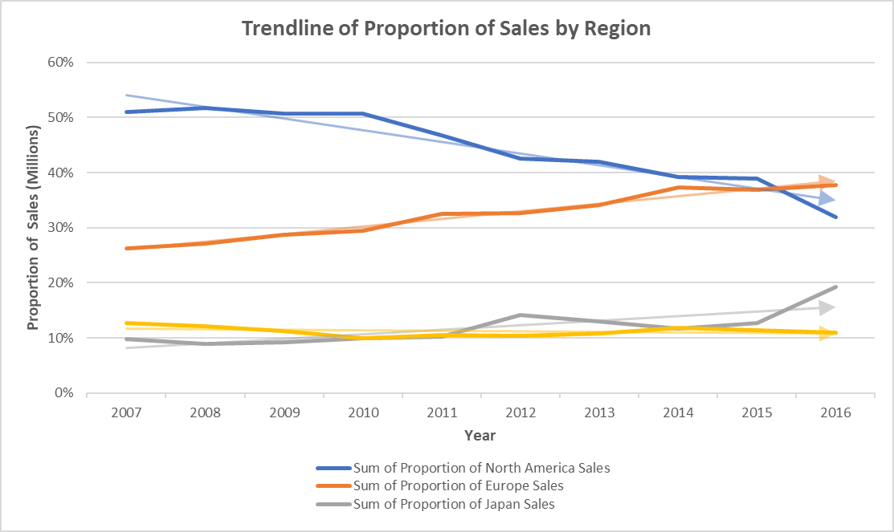
Recommendations
Region | Priority | Budget Allocation | Comment
North America | High | 35% | Focus investments on Action and Shooter games, with attention to emerging genres like Fighting.
Japan | High | 30% | Prioritize the budget for Role-Playing dominance and support Action.
Europe | Medium | 25% | Prioritize Action, Shooter, and Sports games while exploring growth in diverse genres.
Others | Low | 10% | Focus on emerging opportunities, especially in Shooter games.
Future Trend

Slide 10
Influenza
Providing staff analysis for medical facilities

Slide 11

Influenza
Providing staff analysis for medical
facilities
Background
Hospitals and clinics in the US need
additional staff to effectively treat
the increased number of patients
during the influenza season.
Methods
- Data profiling and integrity
- Data Integration
- Statistical hypothesis testing
- Data visualization with Tableau
- Forecasting
Tools
- MS Excel
- Tableau
Goal
- Develop a plan to forecast additional staff demand for the influenza season.
- Analyze influenza trends to guide staffing needs nationwide.
Data
The dataset was collected
from the US Centers for
Disease Control and
Prevention (CDC) and
the US Census Bureau.
Links
1. Raw Data (CDC)
2. Raw Data (US Census)
3. Tableau Presentation
4. Additional Files Related
to This Project

Slide 12
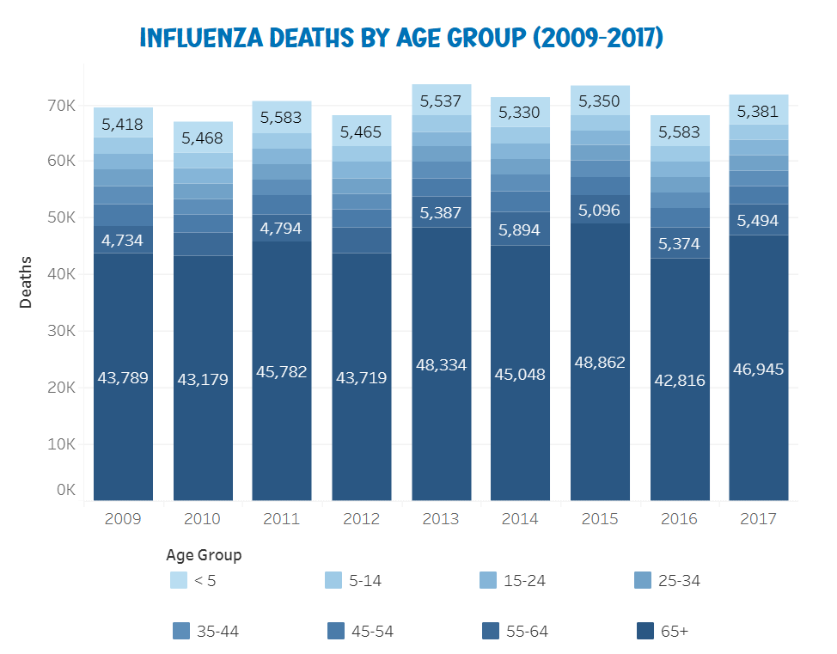
Result and Insights
Influenza Death by Age Group (2009 - 2017)
Age groups under 5 and over 65 have significantly higher total death rates compared to other age groups. Together, these two age groups account for over 70% of the total influenza-related deaths.

Slide 13
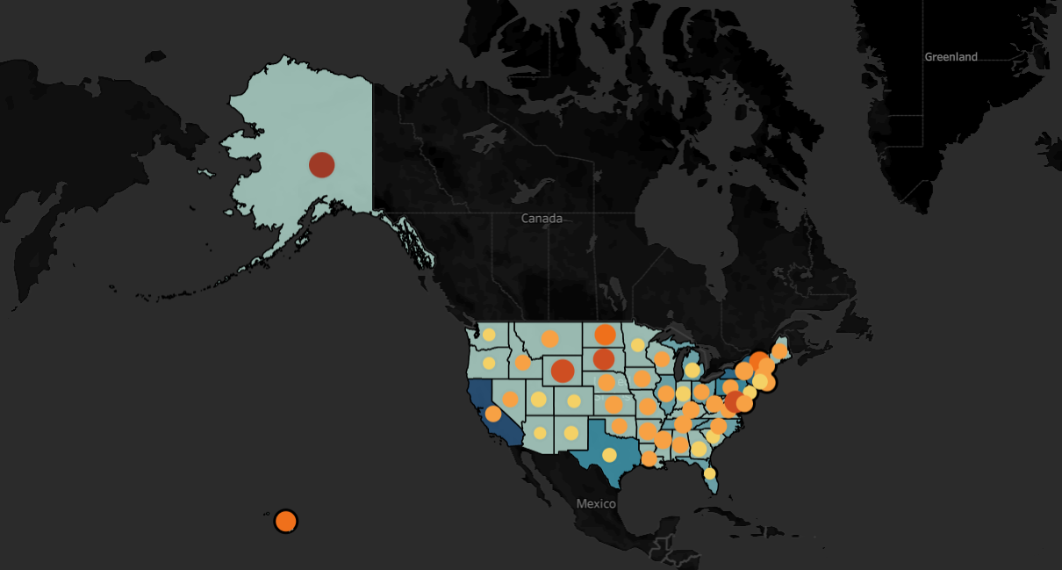
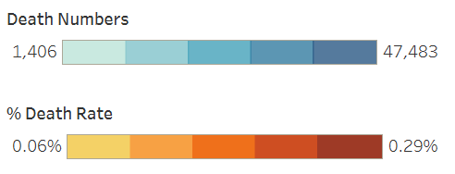
Result and Insights
Influenza Death Numbers VS Death Rates of 65+ by State (2009 - 2017)
The states with the most deaths are California, New York and Texas.
The states with the highest death rates are Alaska, Wyoming and Hawaii.

Slide 14
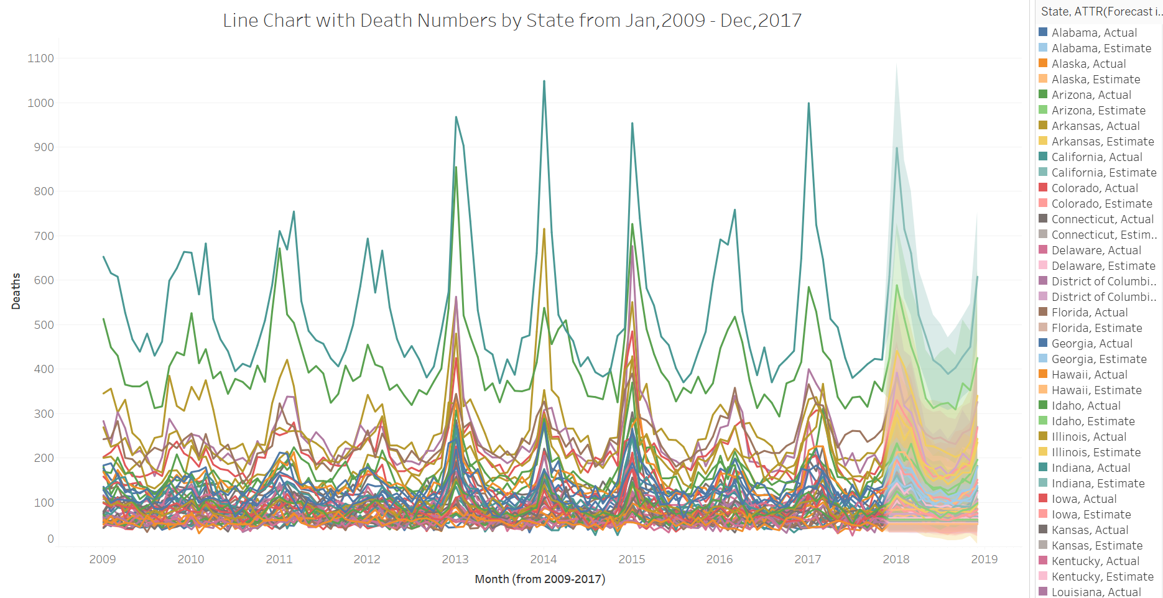
Result and Insights
Based on the analyzed data, the highest death numbers occur in the first and fourth quarters, which correspond to the fall and winter seasons.

Slide 15
Recommendations
Staffing Based on Risk:
Clinics should allocate additional staff and resources to individuals aged 55 and older, particularly during the first and fourth quarters, when the risk of influenza-related deaths is highest.
Geographic Focus:
Health systems in the ten most affected states (as identified in our analysis) should receive extra resources and staff, especially during flu season, to help reduce mortality rates.
Continuous Monitoring:
The eight states predicted to experience rising influenza-related deaths post-2017 should be continuously monitored to ensure their preparedness, as influenza death rates tend to peak during the fall and winter seasons.
Vaccination and Education:
Efforts to strengthen vaccination campaigns for high-risk groups should be prioritized, with a focus on educating the public—particularly in states most heavily affected by influenza.
Data-Driven Planning:
Predictive models should be used to plan staffing and resource allocation in advance of peak influenza season, ensuring that clinics are adequately prepared to handle the increased demand.

Slide 16
Rockbuster Stealth
Strategy analysis for the new online video service

Slide 17
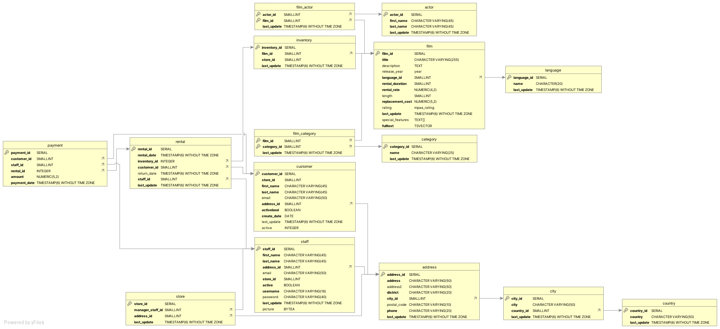
Rockbuster Stealth
Strategy analysis for the new online
video service
Background
Rockbuster Stealth is facing stiff
competition from streaming
services. The management team is
planning to launch an online video
rental service to stay competitive.
Methods
- PostgreSQL
- Data cleaning in SQL
- Joining Tables
- Subqueries & CTEs
Tools
- MS Excel
- Tableau
- SQL
Goal
Provide data-driven insights to assist the management team of Rockbuster Stealth LLC in strategically launching their new online video rental service.
Data
The dataset includes information about Rockbuster’s film inventory, customers, payments, and other relevant details, as illustrated in the data diagram below.
Links
1. Tableau Visualizations 2. Additional Filed Related to This Project

Slide 18
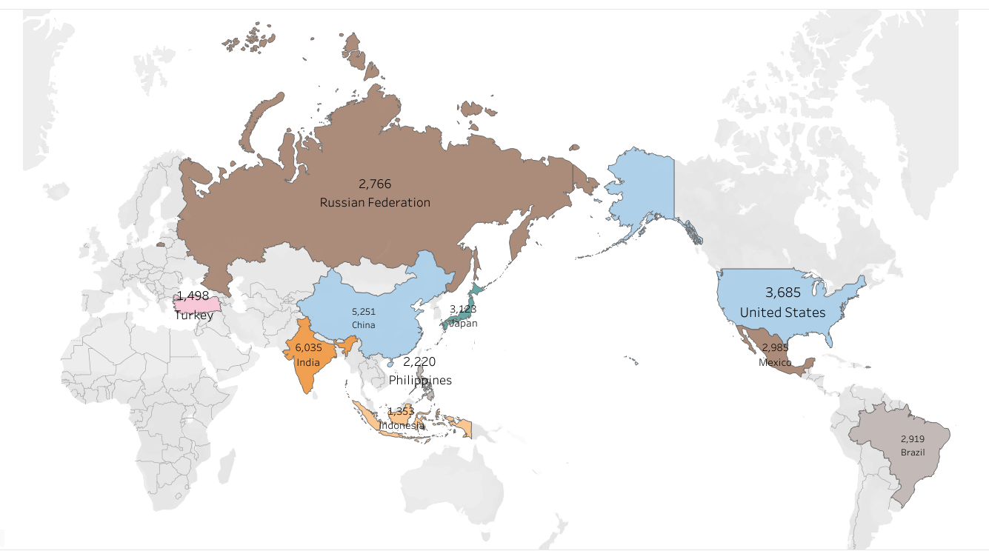
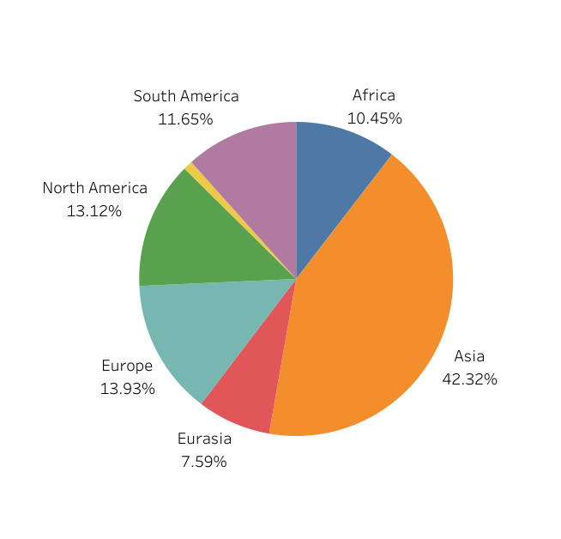
Result and Insights
Analyzing Our Customer Distribution: A Global Overview
Customer Distribution Analysis: Regional Overview
1. India
2. China
3. USA
4. Japan
5. Mexico
6. Brazil
7. Russia
8. Philippines
9. Turkey
10. Indonesia
Rockbuster operates in 109 countries worldwide, with just 10 countries accounting for more than 50% of the total customer base.
Asia has the highest sales, accounting for over 40%, while Oceania has the lowest, with less than 8%.

Slide 19
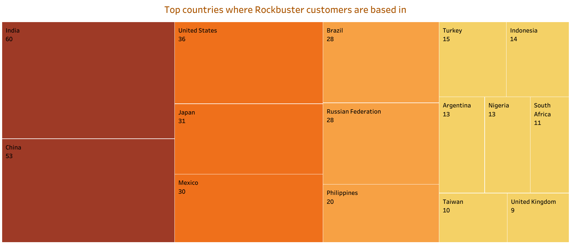
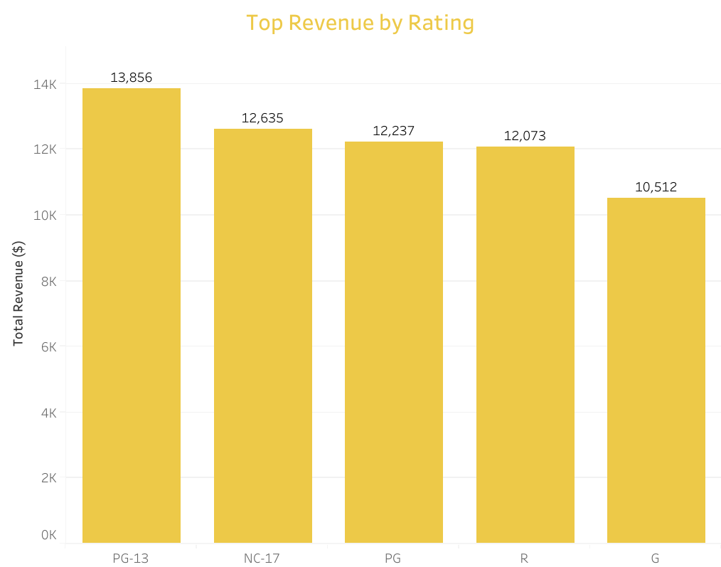
Result and Insights
Analyzing Our Customer Distribution:
Overview of Countries Where Customers Are Based
Customer Distribution Analysis: Top-Performing Genres by Revenue
1. PG-13
2. NG-17
3. PG
4. R
5. G
India, China, the USA, Japan, and Mexico are the top five countries where Rockbuster customers are based, each with a customer range of 30 to 60.
PG-13 rating has the highest total revenue. It has 9.66%
in total revenue higher than the second one (NC-17).

Slide 20
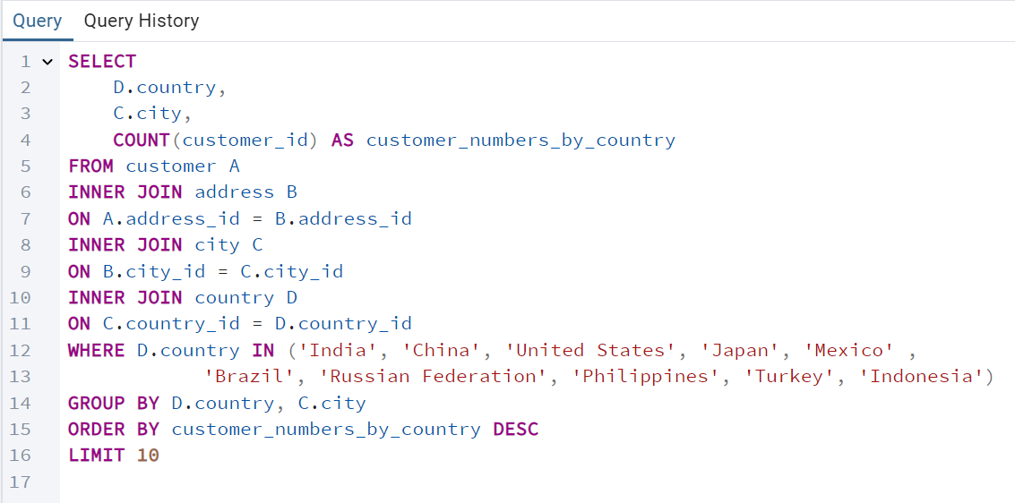
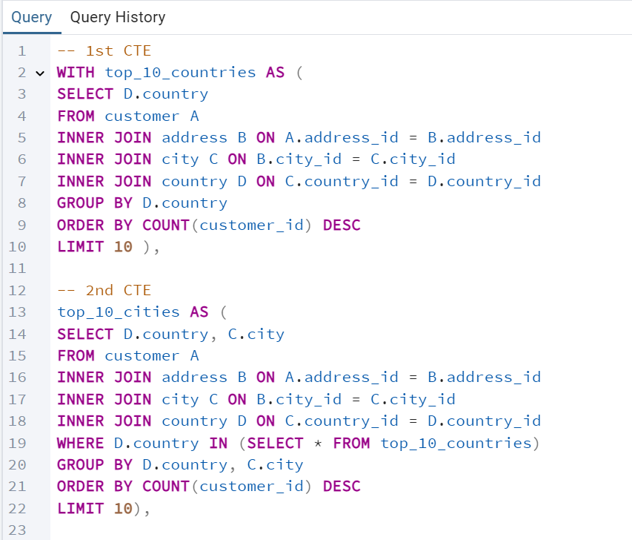
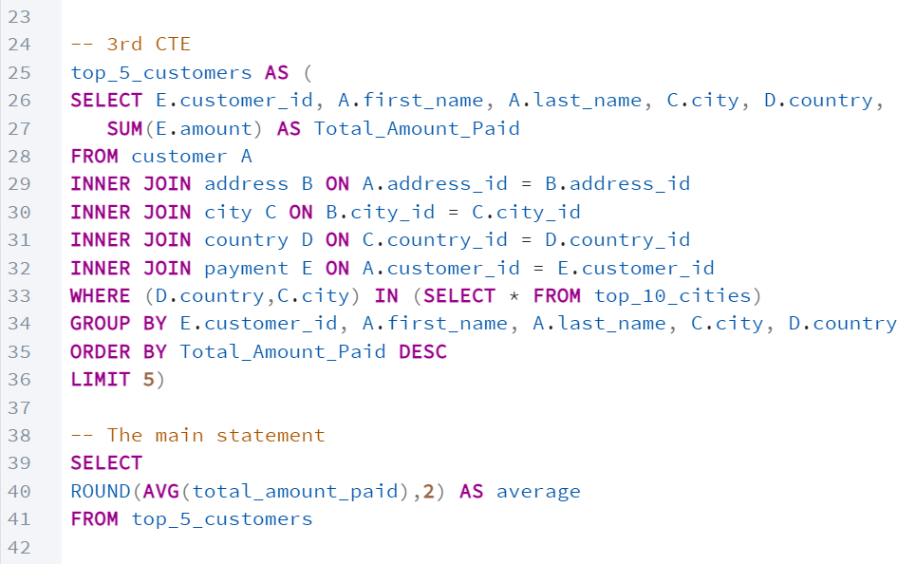
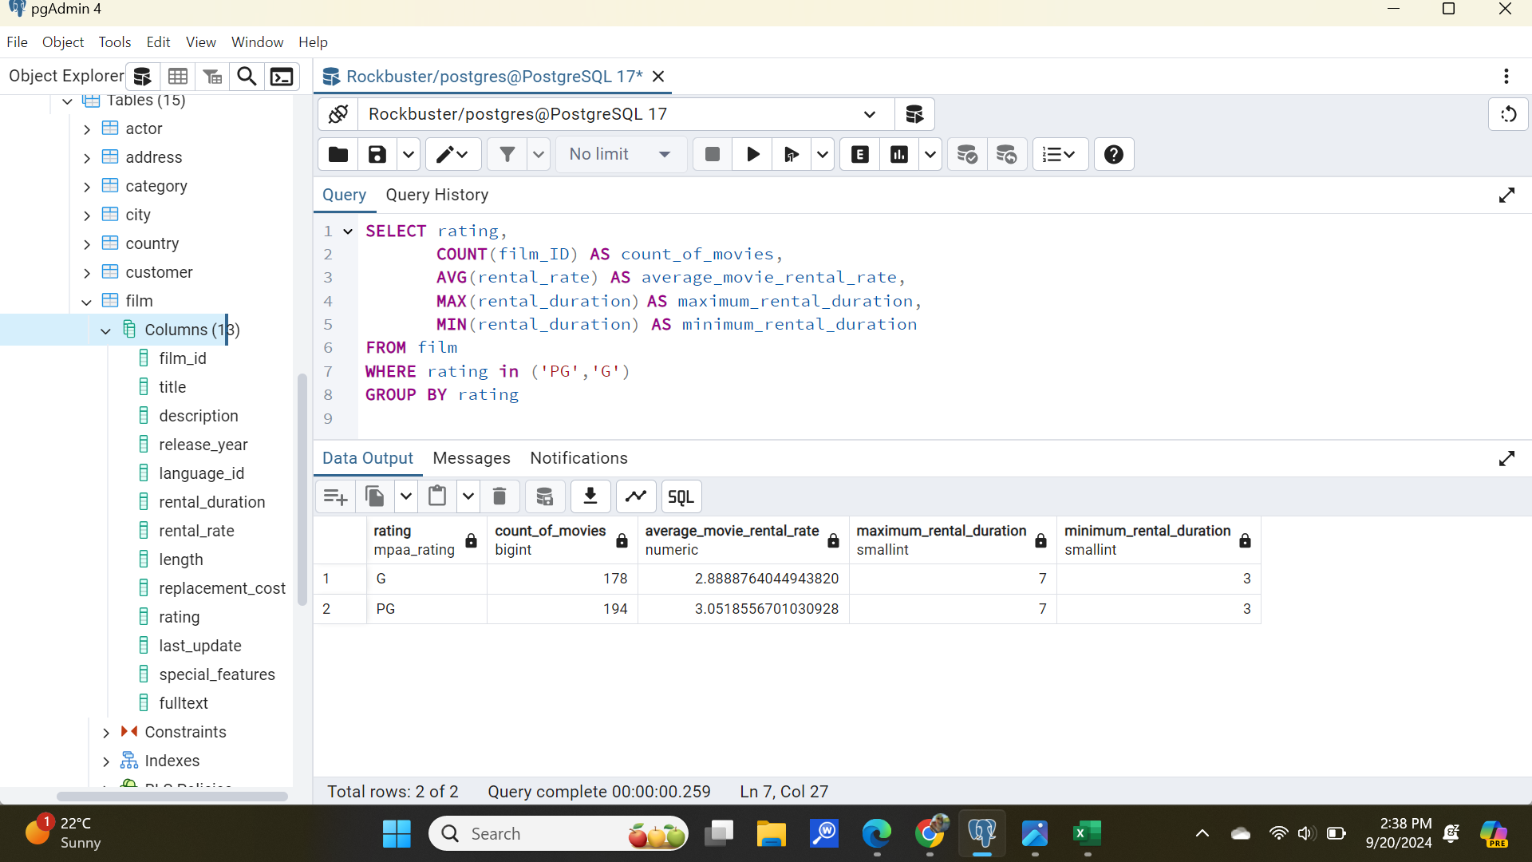
SQL Code Examples
Joining Tables
Common Table Expression
Aggregate Functions

Slide 21
Recommendations
Geographic Market Expansion
- Asia's total revenue accounts for over 40%. Consider investing in strategies to maintain customer engagement in this region, such as implementing a loyalty program.
- Develop strategies to boost revenues in Oceania and South Africa.
Targeted Marketing by Rating
- PG-13 and NC-17 rated movies generate the highest revenues. Rockbuster should focus marketing efforts on promoting movies with these ratings.
- Investigate the reasons behind the low revenue from G-rated movies, despite their broad age appeal. Additionally, create promotional campaigns to increase sales for these movies.
Expand Inventory of High-Revenue Movies
- Analyze the top 5 least revenue-generating movies to determine if they should remain in stock. Would it be more beneficial to stock more high-demand, high-revenue movies instead of keeping low-demand movies on hand?
Optimize Long Rental Duration
- The data shows that movies with shorter rental durations generate more revenue. Explore solutions to increase revenue from long-duration rentals while maintaining customer satisfaction, such as adjusting prices or increasing the availability of these movies in the inventory.

Slide 22
Instacart
Analysis to uncover data on sales patterns

Slide 23
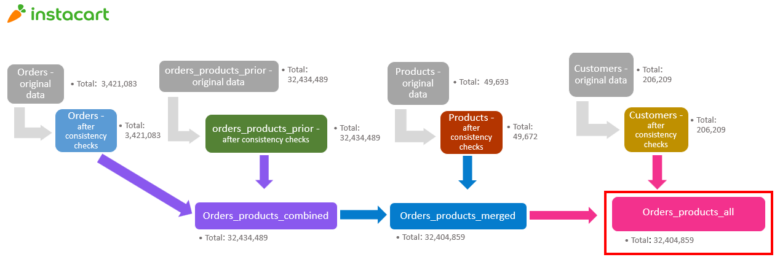
Instacart
Analysis to uncover data on sales
patterns
Background
Instacart stakeholders are interested
in customer variety and purchasing
behaviors to target different
segments with marketing
campaigns and assess their impact
on product sales.
Methods
- Data wrangling and subsetting
- Merging data frames
- Grouping and aggregating data
- Data visualization with Python
Tools
- MS Excel
- Python
Goal
Performing initial data exploration and analysis to uncover sales patterns, aiming to generate insights and recommend strategies for better customer segmentation.
Data
The dataset was collected from an open-source platform provided by Instacart.
Links
1. Raw Data 2. Python Scripts, Visualizations and Additional Files
Instacart’s expense dataset includes crucial information related to customers, payments, and inventory. The visualization above highlights the population and the necessary dataset integrations for conducting this analysis.

Slide 24
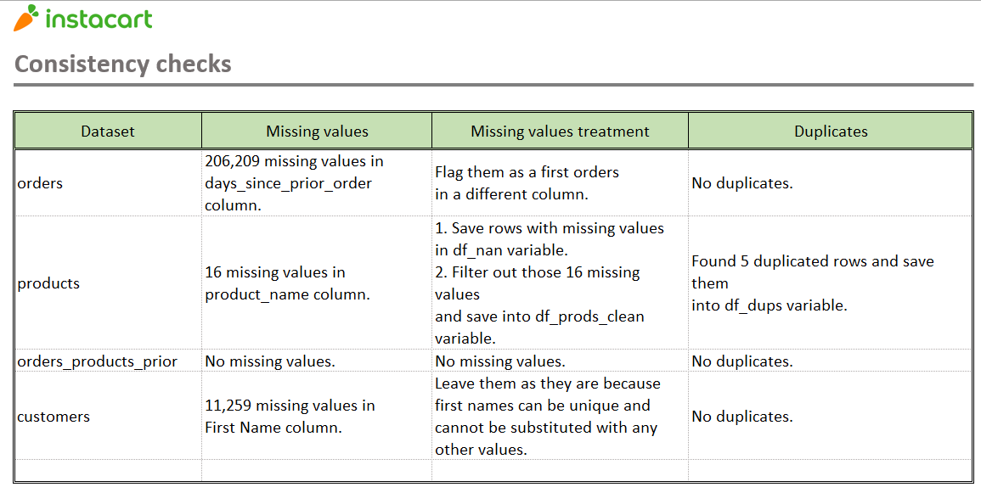
Analytic Process
1. Data Wrangling: Explored and cleaned the datasets for analysis.
2. Data Merging: Merged multiple datasets into a unified dataset using the merge function.
3. Deriving Variables: Created new variables through if-statements and for-loops.
4. Grouping and Aggregating Data: Grouped the data using the groupby function and performed aggregations with agg, transform, and loc functions.
5. Visualization: Developed bar, line, and bubble charts using Python for data visualization.
6. Report Writing: Compiled an Excel report summarizing results and key insights.
Summary of consistency checks, which is part of the process performed in Python. This step ensures that the data follows expected rules and patterns.

Slide 25
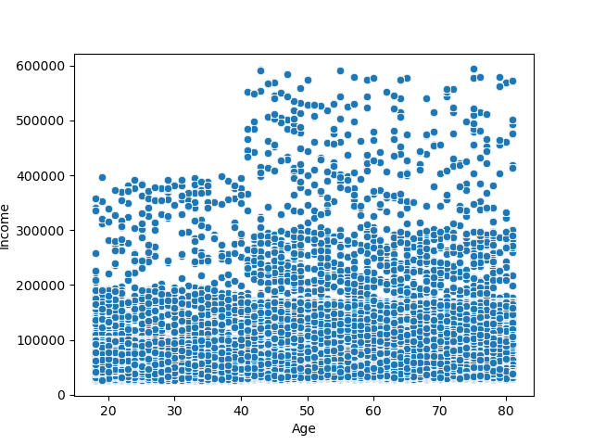
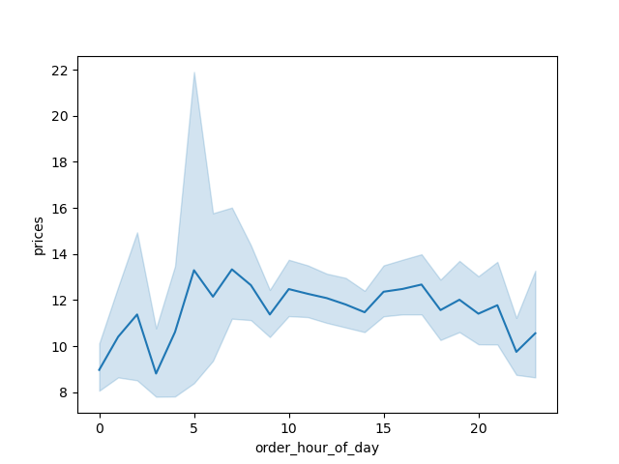
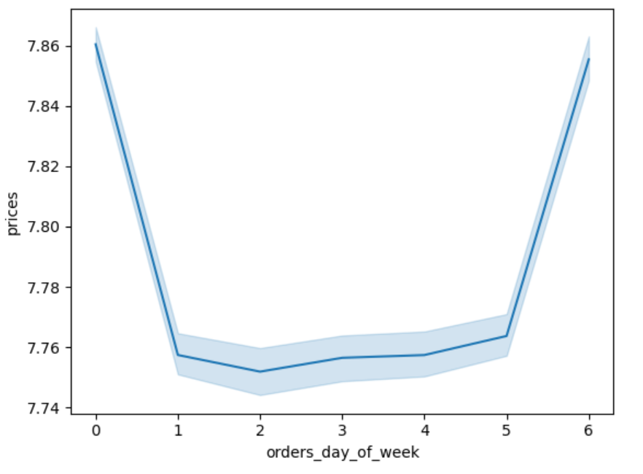
Result and Insights
The scatterplot indicates that individuals aged 40 and above are more likely to earn higher incomes, particularly between $40,000 and $60,000.
The charts show that prices are higher between 5 and 8 hours. Additionally, the error bands suggest that prices are statistically more likely to fall within the higher range at hour 5 than at other times.

Slide 26
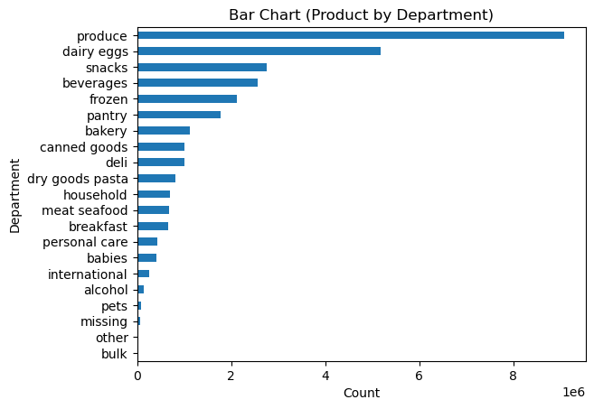
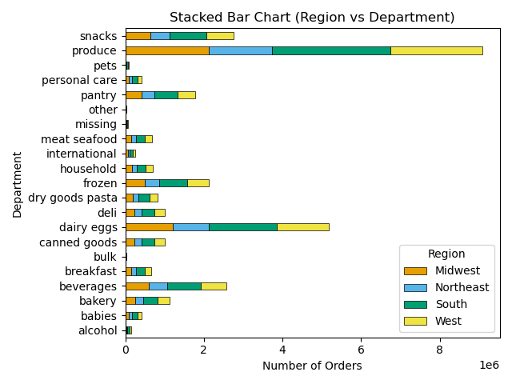
Result and Insights
The charts show that product from produce department contributes the highest frequency on this dataset followed by dairy eggs and snacks. The demographic in terms of department product shows that the Southern region has the most potential on purchasing items across all regions

Slide 27

Recommendations
Launch promotions to upsell on weekdays, targeting
slow hours (7 p.m. to 5 a.m.).
2. Loyal customers are most likely to return. A loyalty
program could encourage more shopping.
3. The new customer group contributes the least. We
should focus on promoting to them.
4. Married people have greater potential. Instacart should
upsell family-related products.
5. The Southern region leads in contributions, so Instacart
should prioritize it. For the Northeastern region, which has
the least contributions, promotions could help boost sales.

Slide 28
Pig E. Bank
Data mining analysis for a global bank

Slide 29
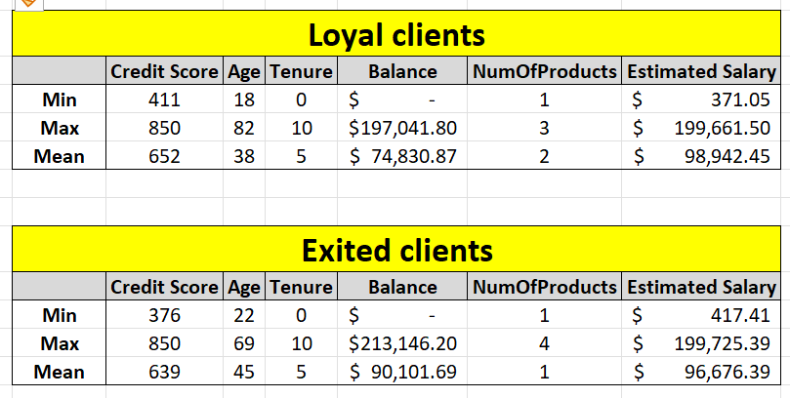
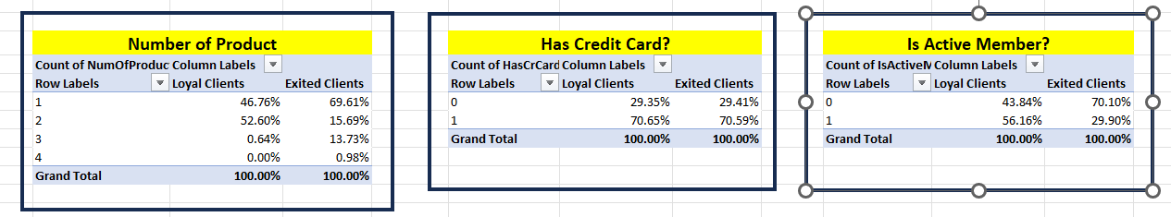
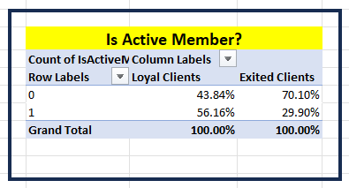
Pig E. Bank
Data mining analysis for a global bank
Background
Pig E. Bank is a global financial
institution with an anti-money-
laundering compliance department.
They develop models to lag
suspicious transactions indicative of
money laundering and fraud.
Methods
- Exploratory data analysis
- Data mining process
- Data modeling
- Time series analysis
- Predictive analysis
Tools
- MS Excel
- MS Pivot Table
Goal
Conduct a comprehensive analysis of bank client data to identify the key factors influencing clients' decisions to leave the bank.
Data
The data was collected from the sales team at Pig E. Bank. The dataset was created as a case study by CareerFoundry.
Links
1. Raw Data 2. Additional Files Related to This Project
The descriptive analysis method (left) and Pivot Tables tool (right) were used in this project to analyze the data.

Slide 30
Result and Insights
This time series chart (right) depicts the monthly revenue trend for the retail business from 1992 to 2016. A clear seasonal pattern is evident, with revenue consistently spiking during the holiday season in November and December each year, likely due to increased consumer spending during that period. Over time, there is a noticeable upward trend in the baseline revenue, indicating steady business growth year over year.
The chart (left) shows non-stationary characteristics with
fluctuations and changing mean and variance over time. From 1987 to 1998, the data was stable but began rising in 1999, followed by a sharp drop in 2008. Overall, there was an upward trend with fluctuations from 1987 to 2008. Between 2008 and 2019, prices swung unpredictably, complicating future forecasting.

Slide 31
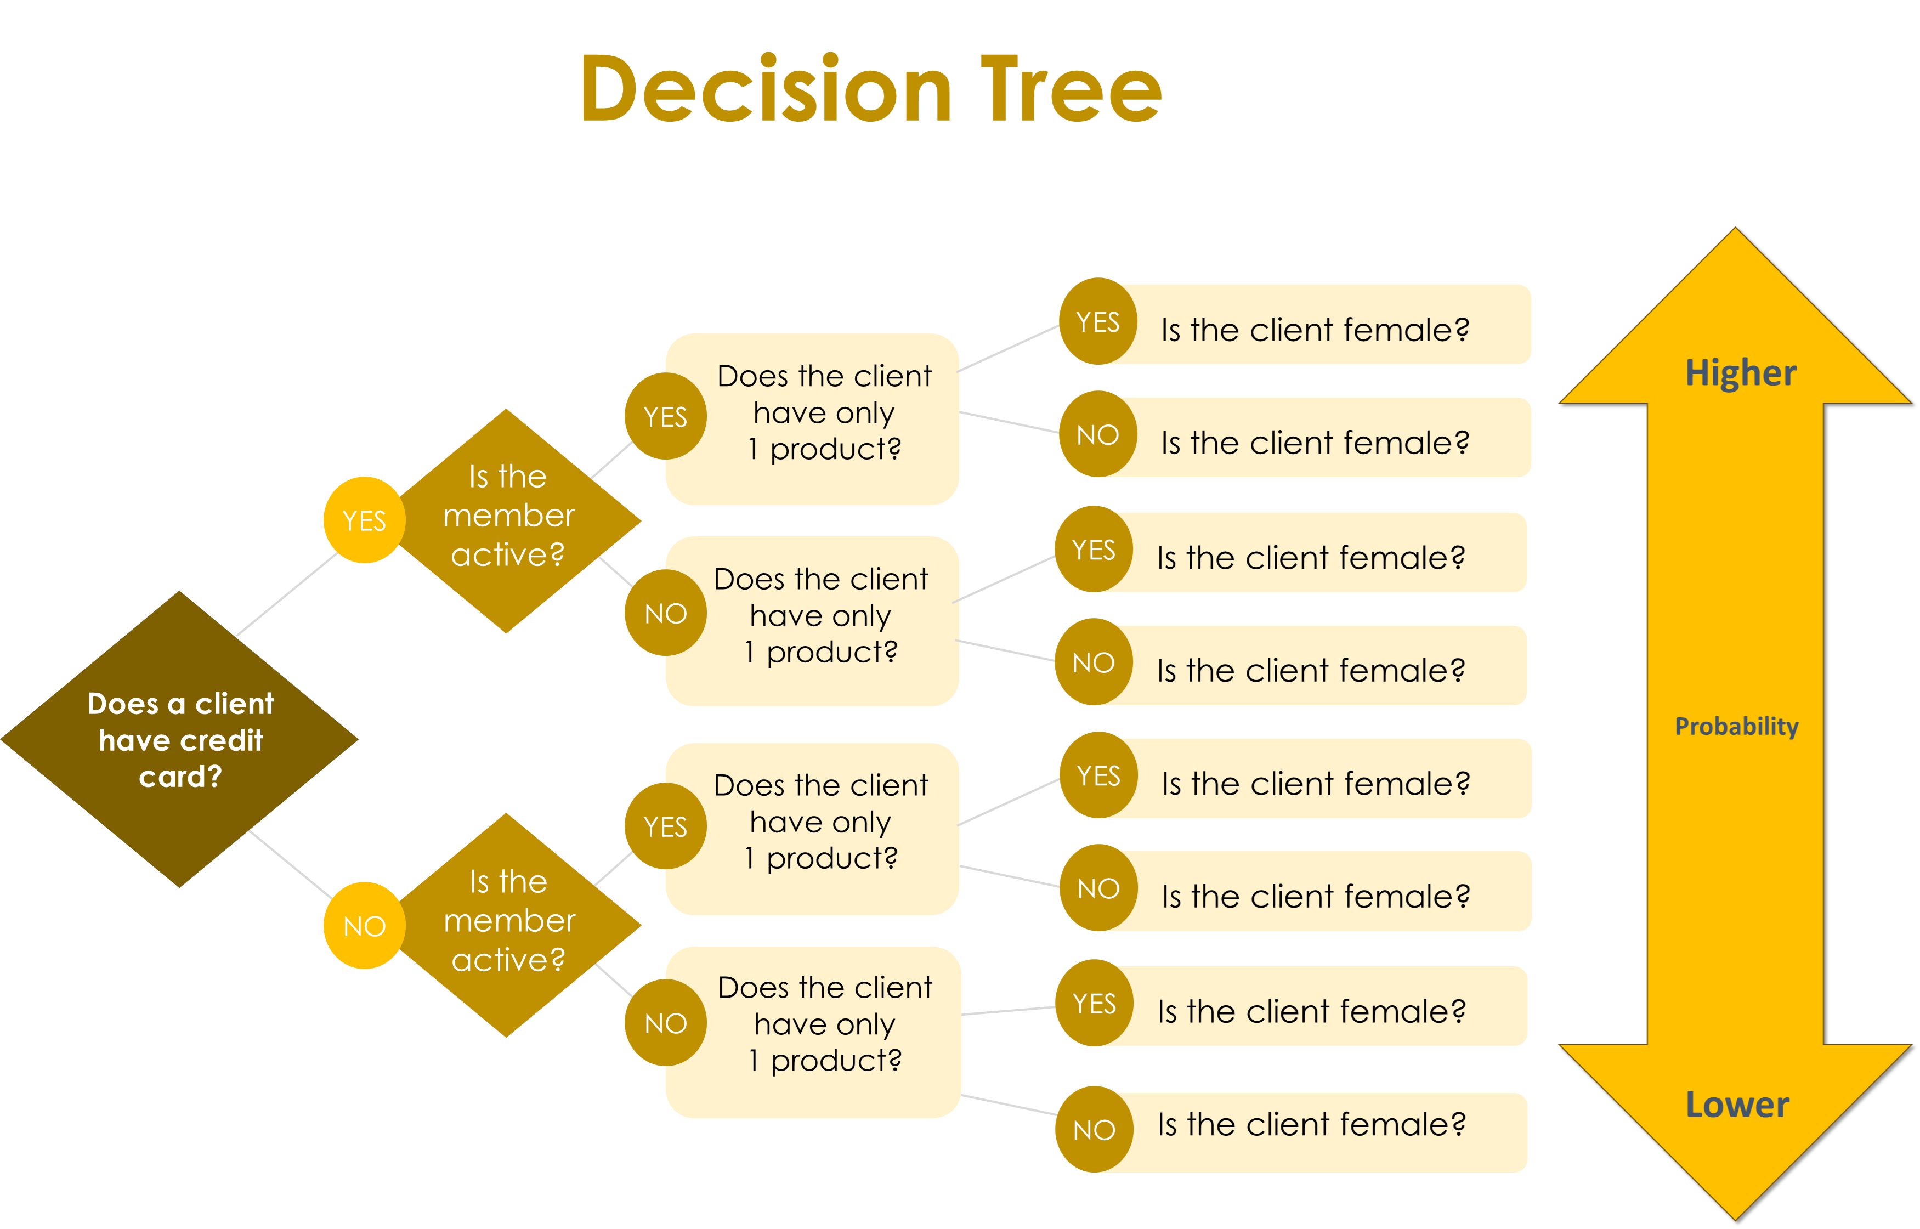
Recommendations
The most impactful factors that cause customers to leave the bank
Has Credit Card?
Is Active Member?
Number of Product
Gender
Build a loyal base that uses more products and stays engaged.
Identify reasons for inactivity and potential product improvements.
Examine what competitors offer to understand their advantage over Pig E. Bank.
A decision tree was used to estimate the probability of customers leaving the bank.

Slide 32
House Sales in King County
Insights into House Prices Uncovered

Slide 33
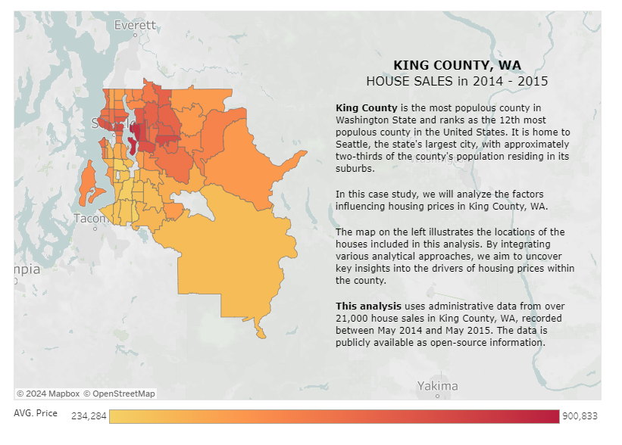
House Sales in King County
Insights into House Prices Uncovered
Background
As a data analyst, my role involves
analyzing King County house
sales data to develop predictive
models for sale prices and
determine the key factors
affecting them.
Methods
- Relationships exploring
- Geographical visualizations
- Machine learning regression
- Machine learning clustering
Tools
- MS Excel
- Python
- Tableau
Goal
Performing exploratory data analysis to identify factors affecting King County house prices, followed by building a machine learning model for price prediction.
Data
This dataset, sourced from Kaggle.com, contains house sale prices for King County, including Seattle. It covers homes sold between May 2014 and May 2015.
Links
1. Raw Data
2. Tableau
3. Python Scripts and
Additional Files Related
To This Project
A choropleth map was created using Python to aid in the analysis for this project.

Slide 34
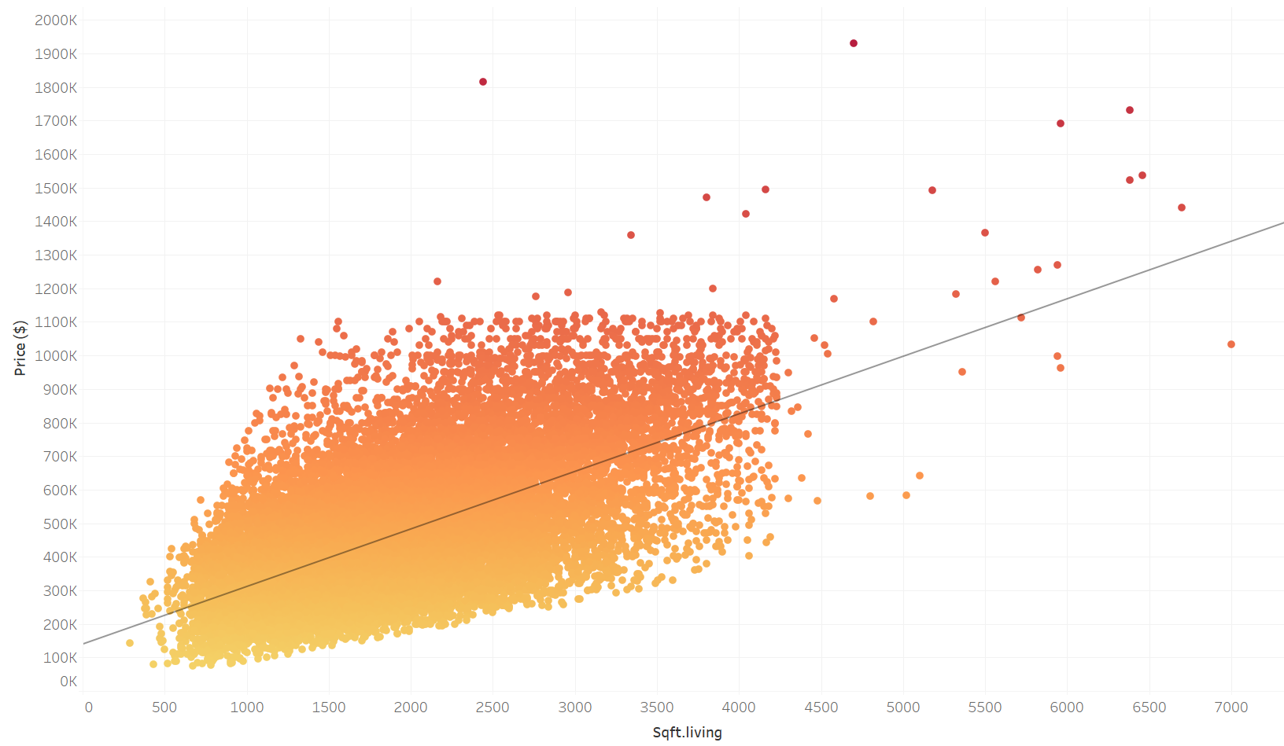
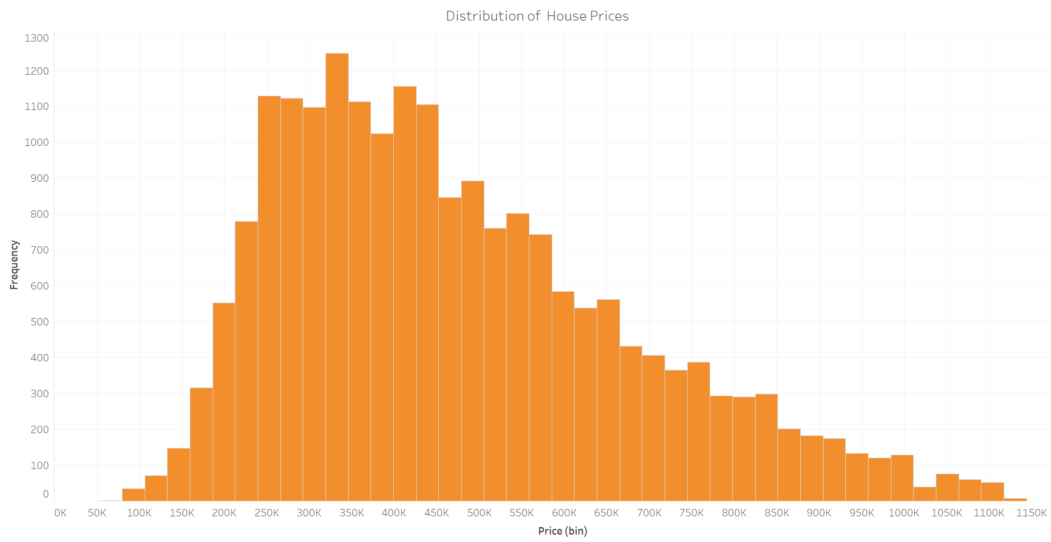
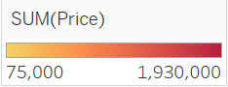
Analytic Process: Exploratory Analysis
The distribution of house prices, as shown in the chart on the left, reveals a wide range, with the majority of prices falling between $200,000 and $450,000. This suggests that certain factors may be driving the variability in house prices.
To explore this further, we begin by examining potential linear relationships between variables. The analysis indicates no significant relationship between the year a house was built and its price. However, the scatterplot above reveals a noticeable trend between living space (sqft_living) and house prices. Specifically, house prices (dependent variable) tend to increase as the size of the living space (independent variable) increases.
This upward trend leads us to the following hypothesis: As the living space (sqft_living) increases, house prices increase.

Slide 35
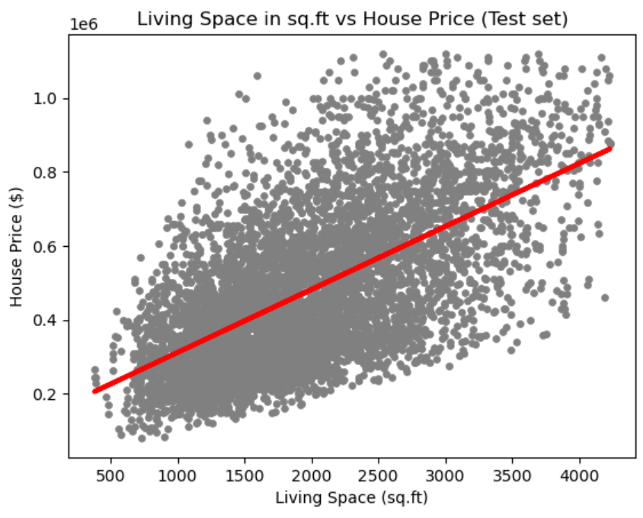
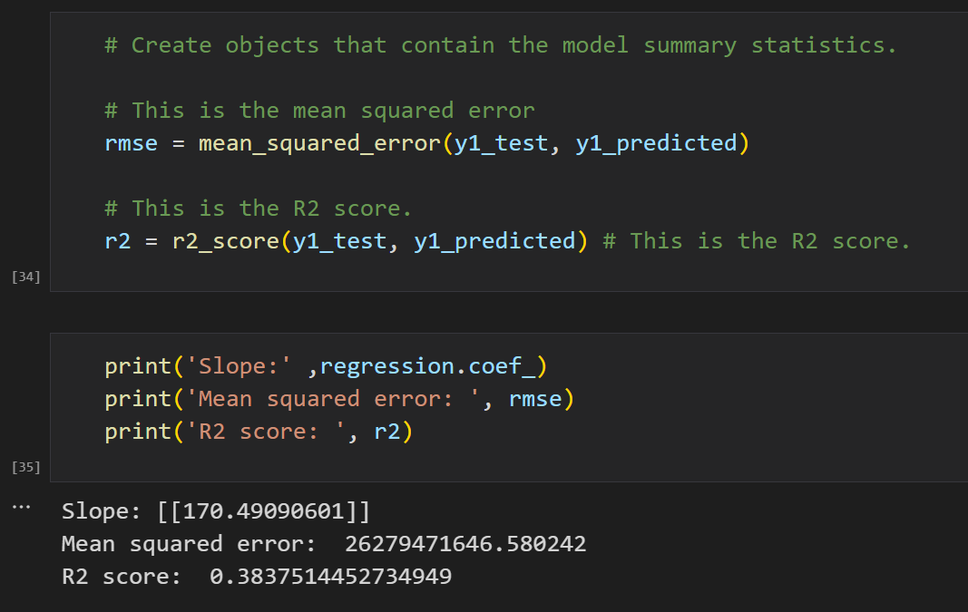
Analytic Process: Linear Regression
Supervised machine learning regression was applied in this analysis. As shown in the chart on the left, the red regression line from the test set aligns with the hypothesis: "Increasing the number of square feet (sqft_living) leads to higher house prices." It is evident that most house prices increase as living space expands.
However, some data points indicate exceptions where larger living spaces do not correlate with higher prices. To assess the model's accuracy, we must use metrics beyond visual inspection. As shown in the lower-left code, metrics like MSE (Mean Squared Error) and R² score are useful for evaluation.
Key observations:
The positive slope supports the hypothesis that larger living spaces generally lead to higher house prices.
An R² score of 0.38 suggests a weak to moderate relationship, with living space accounting for only 38% of the variation in prices.
The scattered data points around the regression line indicate that the relationship is not entirely linear. Since linear regression does not fully capture the data, exploring alternative modeling approaches is recommended.

Slide 36
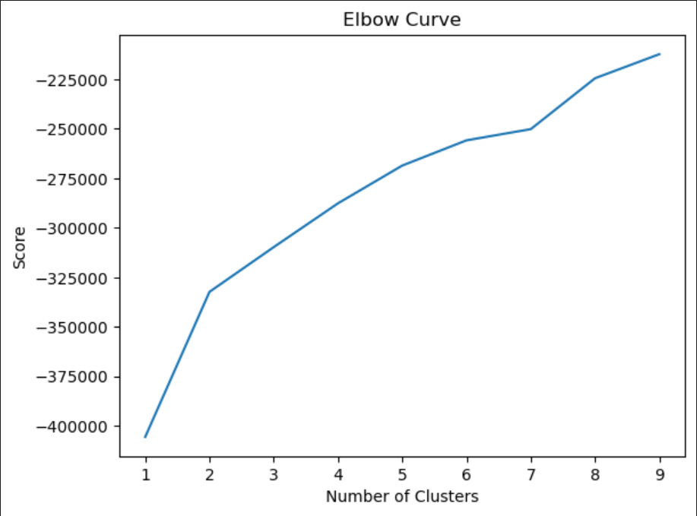
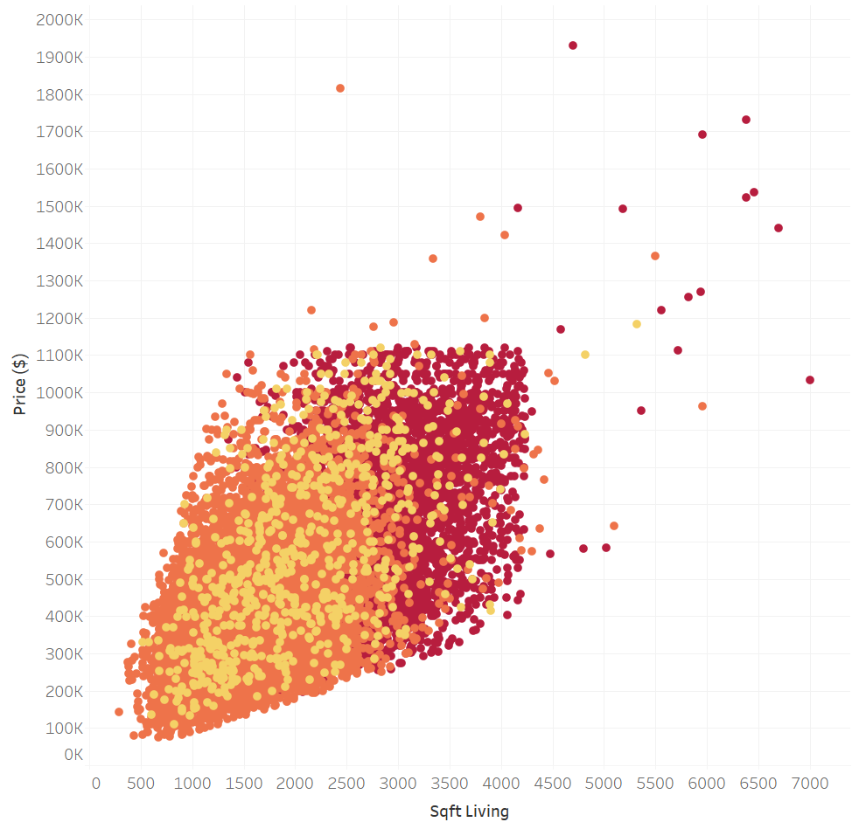
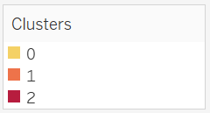
Analytic Process: Cluster Analysis
Elbow technique and k-means method were used for this unsupervised machine learning analysis.
The ideal number of clusters is where the "elbow" appears where the score's improvement slows. In this chart, the elbow is at 3 clusters, testing with clustering with 3 clusters is appropriate as a starting point.
K-means predicts the 'clusters' column (from the standardized dataset) to the original dataset. This step links each cluster to the original dataset for better representation. It will be useful in the final analysis to calculate the real average and median values of each variable, providing meaningful statistical insights.
Cluster 2 (Dark red)
This cluster stands out with the highest statistics across almost all variables. It represents luxurious houses with expensive prices, located in affluent neighborhoods and offering full amenities.
Cluster 1 (Orange)
This cluster clearly has the lowest statistical values across most variables. It indicates affordable houses with the lowest prices, older properties, and fewer amenities, likely located in less wealthy neighborhoods.
Cluster 0 (Yellow)
This cluster represents mid-range houses, with most variables falling at moderate levels. However, the analysis suggests that this cluster skews toward the lower and more affordable house category, despite being classified as mid-range.

Slide 37
Summary and Recommendations
1. Linear Regression:
Applying linear regression in machine learning helps identify significant relationships between variables in the dataset. From this method, we observed that increasing the number of square feet (sqft_living) generally leads to higher house prices. However, the regression output indicates that the relationship is not entirely linear. The data points scattered around the regression line suggest that other factors also influence house prices. Exploring additional techniques such as clustering analysis can provide deeper insights.
2. Clustering Analysis:
Clustering analysis allows us to uncover insights that may be overlooked with linear regression. This method treats all variables equally without introducing bias. By applying this machine learning algorithm, we identified three distinct groups of houses: luxurious, mid-range, and affordable.
3. Key Insights:
- Houses with the highest price per square foot are predominantly located in densely populated areas, such as Seattle and Bellevue.
- Square footage (sqft_living) has the strongest influence on house prices, while other factors, such as the number of bedrooms/bathrooms, property condition, and year built, have a relatively minor impact.
4. Next Steps:
- Update the Dataset: Collect recent home sales data to analyze price trends over time and validate current market insights.
- Incorporate Additional Features: Examine the impact of additional factors, such as proximity to amenities, school districts, and neighborhood crime rates, on house prices.

Slide 38



THANK YOU
Connect with me
Email
Tableau
GitHub

